Slide 1
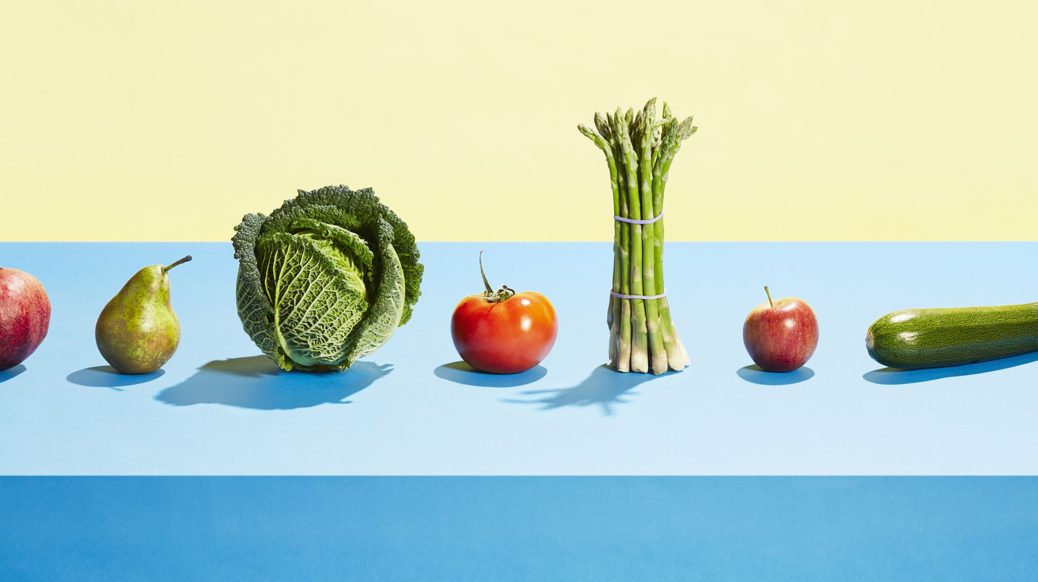
Food & Sustainability
Corey S. Flynn, MPPM, NDTR

Slide 2
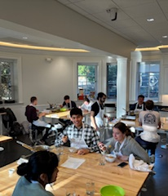
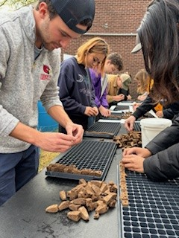
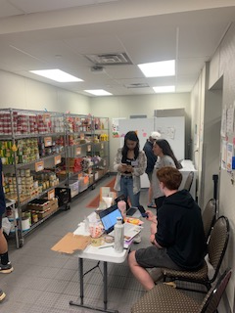
About Me
Notes:
I grew up in Northern California. My father’s family had a large rice farm north of Sacramento. My mother’s family had a cherry orchard. I grew up eating fresh fruits and vegetables picked right outside our front door. When we moved to Pittsburgh is when I really think my obsession with food started. I started by going back to school at CCAC to become a Certified Dietary Manager, Certified Food Protection Professional, and Dietetic Technician. I worked with the Food Service Director at Mt Lebanon High School to build the compost station in the new cafeteria and then went to work for Women Infant Children for the county. But, I wanted to make more of an impact, so I went back to school for my Masters in Public Policy and Management at GSPIA. During my time at GSPIA I became obsessed with food policy and the idea of a sustainable food system and what that looked like in an urban and suburban community like Pittsburgh. Long story short, I decided to go for my doctorate which I am working on right now. I started out looking at sustainable food systems and realized you cannot have a sustainable food system if one person is hungry. A population that is often overlook is our college students so that is my current research focus. I teach cooking classes at Phipps, and I teach a course called Introduction to Sustainable Food Systems.

Slide 3
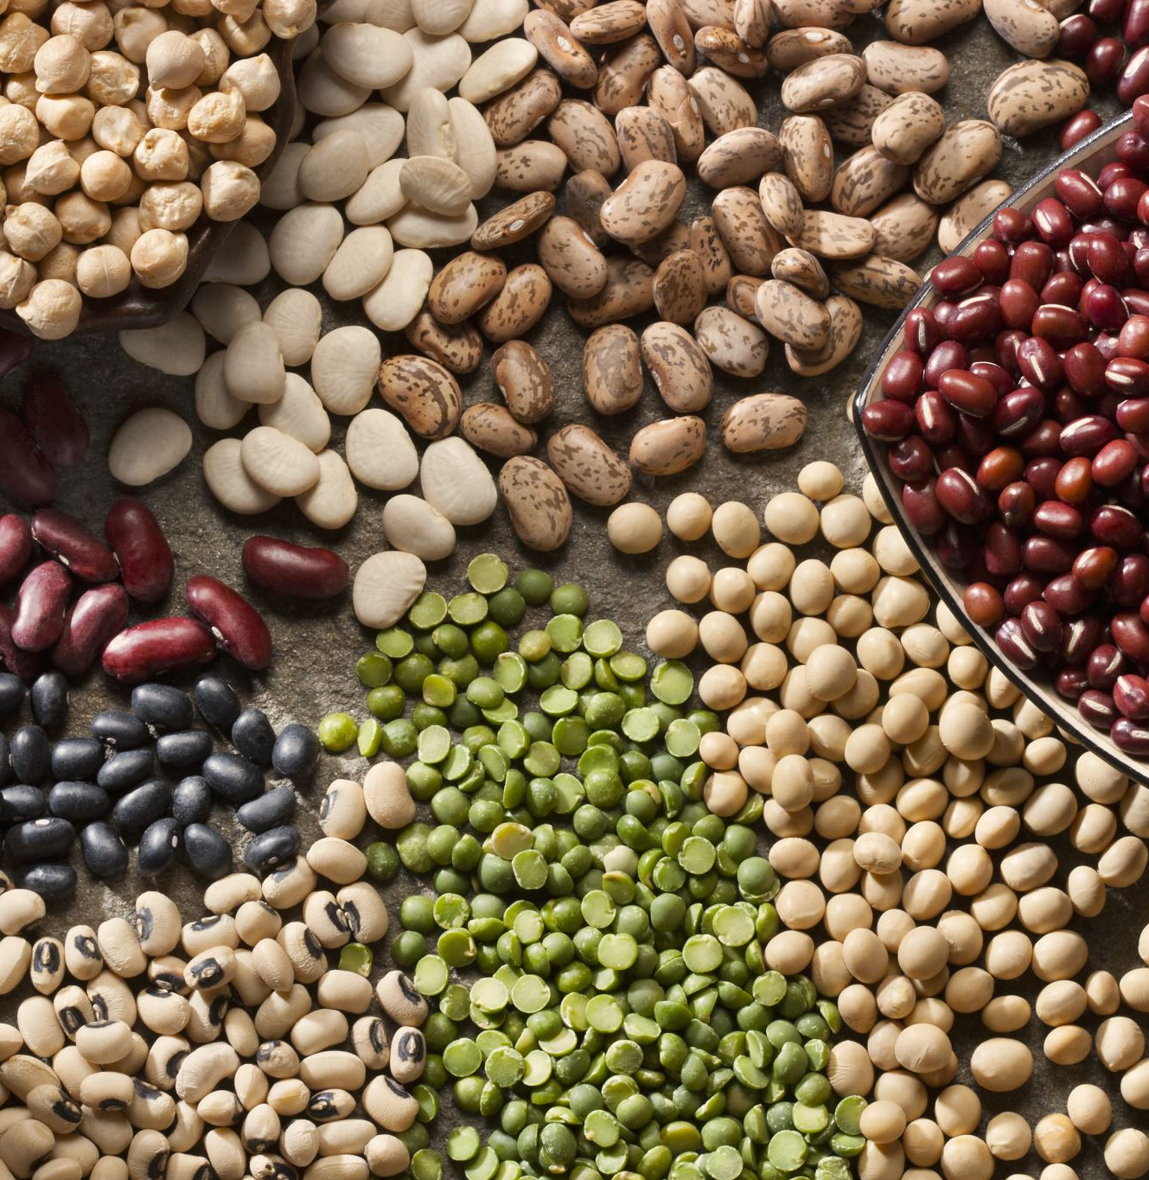
Food
“Food is one of the most meaningful and personal topics to study because everyone knows something about food. Food is one of the essential requirements to sustain life.”
-Food Studies: A hands on Guide by Willa Zhen
Notes:
So, why food?

Slide 4
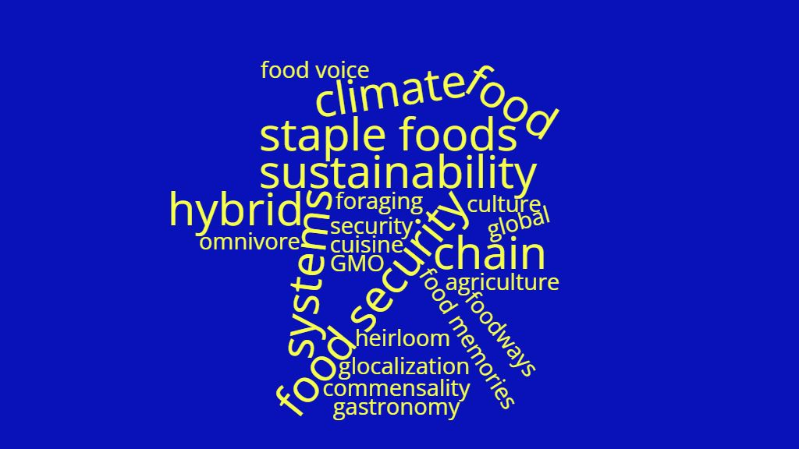
Notes:
AND Food is diverse! There is so much about food! I am sure you have heard your food described as organic, non-GMO. Food is a big topic! Yesterday in my all-day doctoral class I was talking about food swamps and food apartheid with my classmates. They hadn’t heard about most of the terms I had mentioned. Food is important in so many ways.

Slide 5
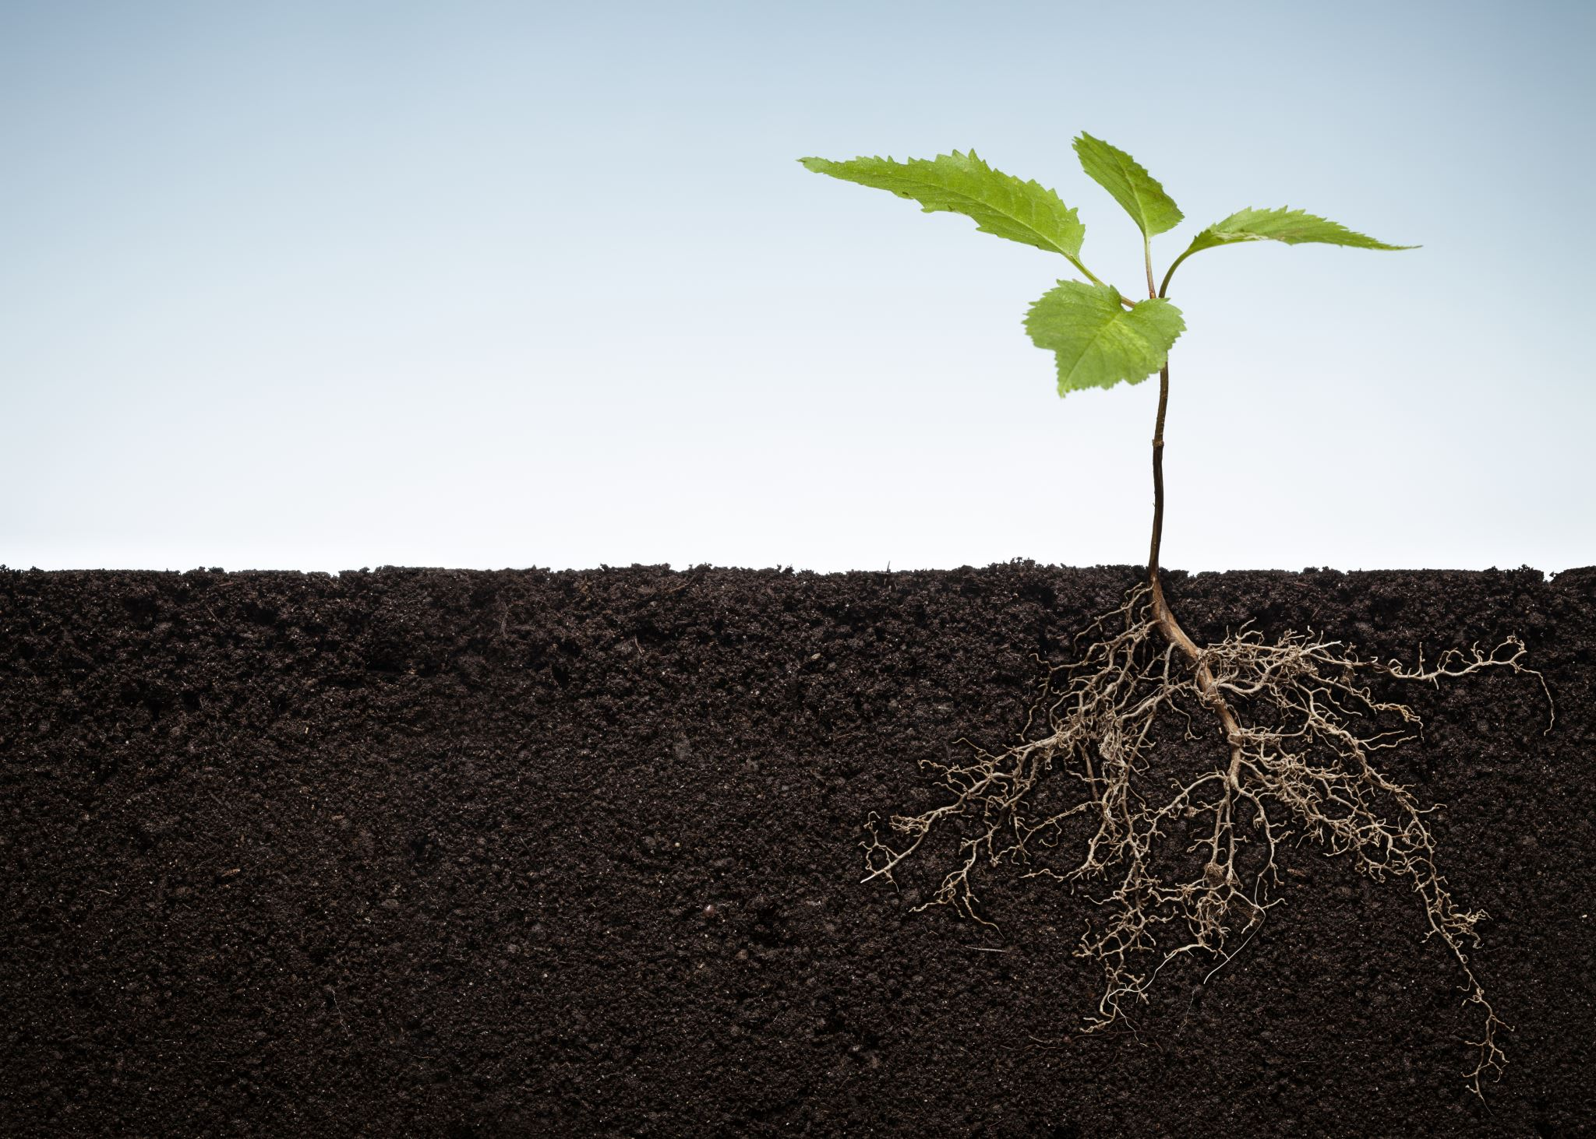
A Sustainable Food System
“Is a food system that delivers food security and nutrition for all in such a way that the economic, social, and environmental bases to generate food security and nutrition for future generations are not compromised.”
Food and Agriculture Organization of the United Nations
Notes:
Well, first, what is a sustainable food system?

Slide 6
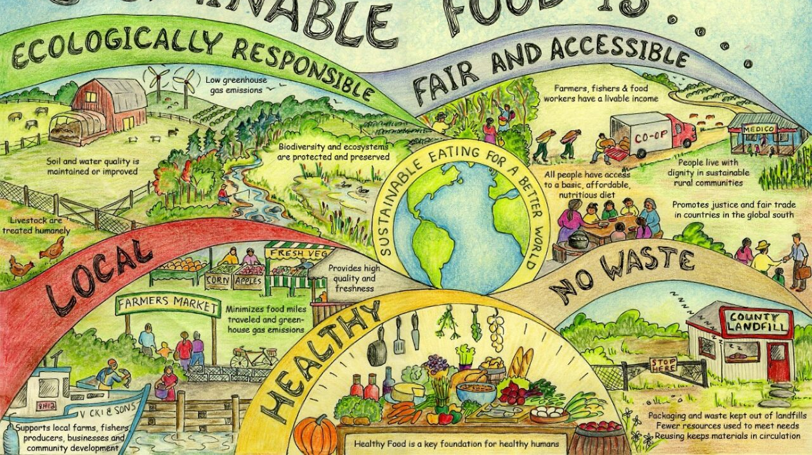
Notes:
I love this image of a sustainable food system. This is from the International Confederation of Dietetic Associations

Slide 7
What impacts our food system?
Notes:
What are some ways that our food system is impacted? One, is natural disasters which are becoming more prevalent with climate change.

Slide 8
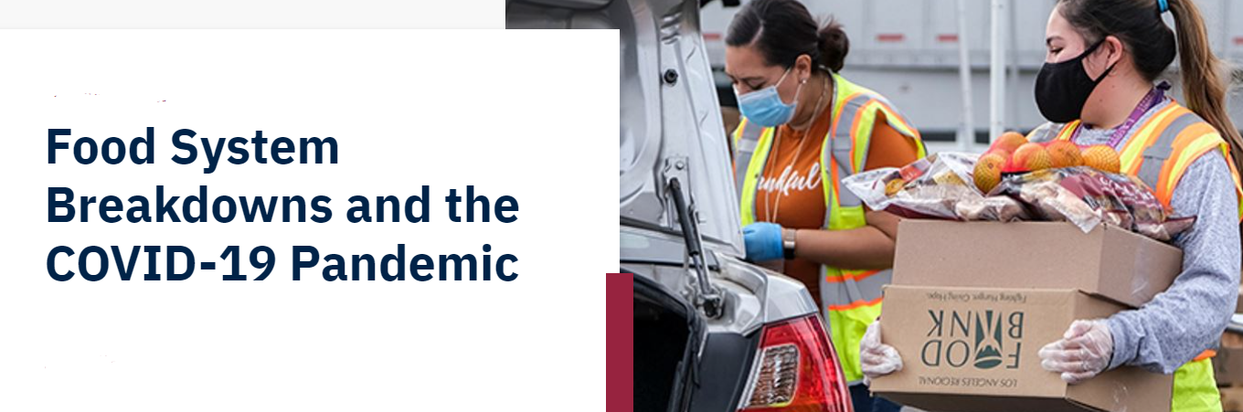
Pandemic
Notes:
The pandemic had a big impact on the food environment. A surge of COVID cases disrupted operations across the entire food system.
As Dr. Potorti of the Massachusetts College of Pharmacy and Health Sciences said, “a weak or broken link or dysfunctional policy, upsets the functionality of the whole system.”
Problems with the food system that became obvious to the world included food injustice and discrimination. Communities of color were disproportionately affected by issues of food access.
The food path or food chain had multiple breakdowns. People were panic buying and hoarding basic need items. Stores had empty shelves while food was going to waste in trucks and fields.
High rates of job loss especially among food service workers. Illness among meat packers and other essential workers. Food insecurity rates rose dramatically.

Slide 9
Our Health
Unhealthy diets, because of choice or lack of access, are a major driver of the health crisis.
Every year, 11 million people die prematurely due to unhealthy diets. We need to make healthy foods available, affordable, and accessible for all people at the same time.
Obesity and diet-related diseases have turned out to be an important risk factor for COVID-19

Slide 10
Food & Culture
Food culture is how we relate to food in terms of believes, practices, and emotions
Notes:
Food provides us with memories and comfort. Sometimes the opposite. I hadn’t heard of perogies before I moved to Pittsburgh. My son lives in Wales, and he makes perogies for his friends! My comfort recipe is avocado pie. My grandmother grew up on an avocado farm in Southern California when it was farms and not highways. Food is important for reminding us of our history and sharing with new friends.

Slide 11
Food & Climate
The human food system accounts for a third of greenhouse gas emissions
Livestock is the most important contributor to greenhouse gas emissions.
Beef accounts for eight to 10 times more impact than chicken and over 50 times the impact on greenhouse gas emissions than beans.
12% of people consumed a disproportionate amount of beef
Consume 50% of the total beef on any given day
Over 50% of the total beef is consumed in mixed dishes such as stew, soup, burritos, tacos, sandwiches, and pasta.
Male, age 30-65
Willits-Smith et al. (2023). Demographic and Socioeconomic Correlates of Disproportionate Beef Consumption among US Adults in an Age of Global Warming. Nutrients. 15(17), 3795; https://doi.org/10.3390/nu15173795
Notes:
How does what we eat affect the climate?
Dietary carbon footprint - greenhouse gas emissions are from the producing. Reduce demand.

Slide 12
Food Apartheid Not Desert
A lot of people say that Pittsburgh is a food desert. However, the term food desert isn’t accurate.
A food desert is a lack of food or areas with poor access to healthy food.
Racially discriminatory political structures were put into place that impacted food access and control.
The fight to end food apartheid is community driven.
Notes:
Amazing work is being done by community groups in the West End, the Hill District, Homewood, Wilkinsburg. United Way of Southwestern PA has been providing micro grants to community groups who are tackling food insecurity issues. One such group is a barber shop and Farm Girl Eb.

Slide 13
Nutrition Security
“Throughout our lives, nutrient-rich and diverse foods ideally support cognition, motor skill and social development, educational attainment, productivity, and lifetime earnings. Beyond healthy, foods preserve and foster social and cultural traditions that link us to other people, and meals are a prominent feature of our everyday lives. In these and many other ways, the foods and meals that make up our overall diets keep us both healthy and socially engaged and can provide the simplest of pleasures. Our days are framed and punctuated by our meals.”
- Can Fixing Dinner Fix the Planet? Dr. Jessica Fanzo, PhD
Notes:
I mentioned that food insecurity became my research focus when I started to dig further into what a sustainable food system is. I have my students read Dr. Fanzo’s book, Can Fixing Dinner Fix the Planet? For my class. It’s a fun read that explains the issue with our food system well.

Slide 14
Notes:
This shows how a diet that is healthy for the environment is also better for you.

Slide 15
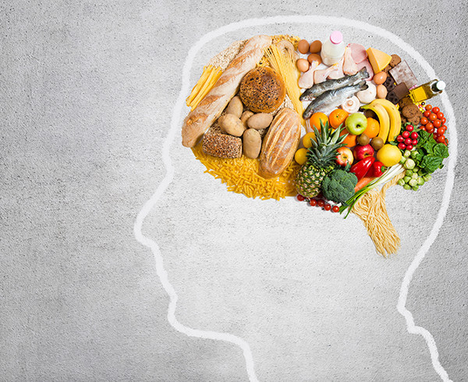
Food for Thought
Kefir
Anchovies & mussels
Lentils
Dark chocolate
Berries
Cashews
Microgreens and sprouts
Dr. Drew Ramsey, MD, Nutritional Psychiatrist, Assistant Clinical Professor, Columbia University
Notes:
And food fuels our brain! These are just a few foods that are good for your body and your brain.
10% of adults in America consume their recommended daily serving of vegetables. Research suggests that ultra-processed, fried and sugary foods increase inflammation in the brain and heighten the risk of developing depression.

Slide 16
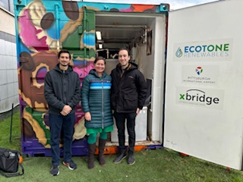
Food Waste
One of the best things we can do for the planet is to stop throwing away food!

Slide 17
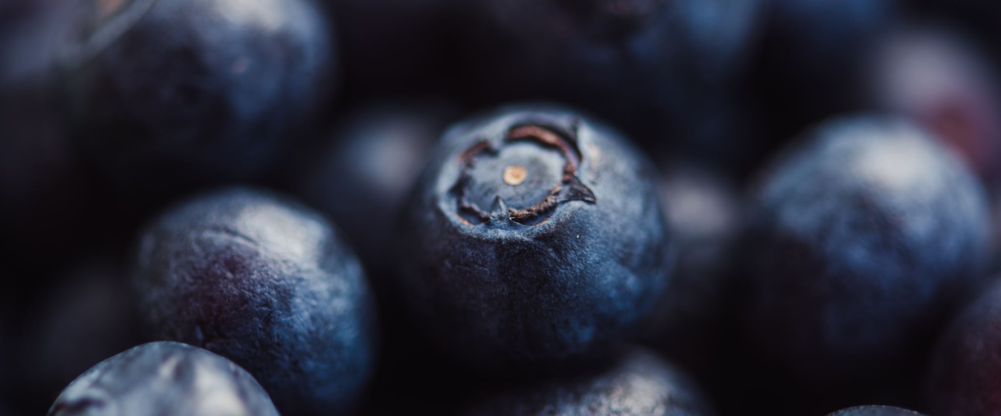
How can you make an impact?
“How we eat determines, to a considerable extent, how the world is used.”
-Wendell Berry

Slide 18
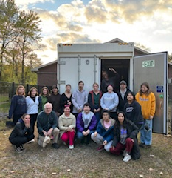
Support Local Businesses
Farmers Markets
Oasis Farm & Fishery
Black Urban Gardeners and Farmers
Hilltop Urban Farm
Peace & Friendship Farm
Garfield Community Farm
Farmer Girl Eb
Blackberry Meadows Farm

Slide 19
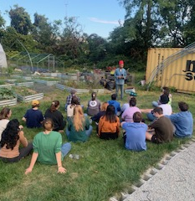
What else?
Grow your own food
Compost
Eat local
Join a CSA
Eat less red meat
Eat more vegetables
Involve children
Volunteer

Slide 20
Commensality
“According to the concept of commensality, sharing food has almost magical properties in its ability to turn self-seeking individuals into a collaborative group.”
-FOOD: The Key Concepts by Warren Belasco

Slide 21
References
-FOOD: The Key Concepts by Warren Belasco
Can Fixing Dinner Fix the Planet? Dr. Jessica Fanzo, PhD
Food Studies: A hands on Guide by Willa Zhen
Zoe Science and Nutrition Podcast
The Leading Voices in Food Podcast

